Slide 1



Slide 2



 | Slope Bins 4 | Smear Count 25
Block number | Alpha w/ Henderson Hasselbalch | Chi Chi_max = 2.2
[0 50] | 0.040012 | 1.160000
[50 75] | -0.278451 | 0.720000
[75 125] | -0.519707 | 0.608000
[125 156] | -0.154453 | 0.529032

Slide 3


 | Slope Bins 4 | Smear Count 31
Block number | Alpha w/ Henderson Hasselbalch | Chi Chi_max = 2.2
[0 31] | 0.001103 | 0.922581
[31 62] | -0.386873 | 0.703226
[62 93] | -0.290146 | 0.967742
[93 496] | 0.037164 | 1.098759
[496 527] | -0.064533 | 0.819355
[527 620] | 0.010682 | 0.756989
[620 647] | -0.103326 | 0.696296

Slide 4
Binary results

Slide 5







For i as L and H:
Pure height profiles
Mixed height profiles
Current L library
Current H library
Skip; marginal increase in vol prob not enough
Move onto chi3.0; larger NFL vol library

Slide 6





All plotting wrong L pure; look only at purp
NFL
NFH
H volume too low to neutralize L (v = 31 nm3/c)

Slide 7







H volume v = 60 nm3/c

Slide 8







H volume too low to neutralize L

Slide 9






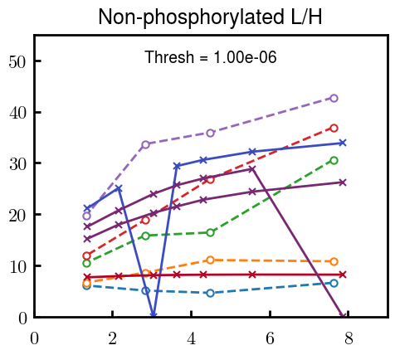


Slide 10



Slide 11
L/H Fitting

Slide 12






Try b change, v same as H (0.15)
Phi unrealistic (?)
Phi unrealistic
Phi very unrealistic
Phi very unrealistic

Slide 13






Try similar params to H
5.6
11.2
16.8
28
56
7.5
11.25
18.75

Slide 14


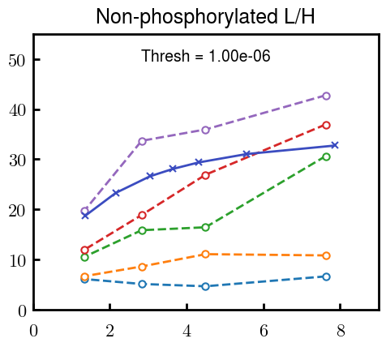
Try similar params to H, b change
7.8
15.6
23.4
31.2
Unrealistic vol

Slide 15


Continuation from prev params

Slide 16







v2.7 and some fine
b1.50 v2.7 c3.2
b1.75 v2.7 c3.2
b1.75 v2.5 c3.2
b1.75 v2.5 c3.0
b2.0 v2.7 c3.2
b2.25 v2.7 c3.2
b2.50 v2.7 c3.2
Phi too small to decrease v0

Slide 17










b2.0 v10.0 c3.0
b2.0 v8.0 c3.0
b2.0 v6.0 c3.0
b2.0 v4.0 c3.0
b2.0 v2.0 c3.0
Phi limit
b1.8 v10.0 c3.0
b1.8 v8.0 c3.0
b1.8 v6.0 c3.0
b1.8 v3.0 c3.0
b1.8 v2.0 c3.0
Phi limit

Slide 18





b1.6 v10.0 c3.0
b1.6 v8.0 c3.0
b1.6 v6.0 c3.0
b1.6 v2.0 c3.0
b1.6 v1.5 c3.0
Phi limit

Slide 19


Response to stimuli given composition
Same data
Effect of composition given environment

Slide 20


NFL, pH 7.44, phos 1.5e (locs from LCMS)
Non-phos NFL
Block number | Alpha w/ Henderson Hasselbalch | Chi Chi_max = 3.2
[0 50] | 0.040012 | 1.540000
[50 75] | -0.278451 | 0.960000
[75 125] | -0.519707 | 0.868000
[125 156] | -0.154453 | 0.690323
 | Slope Bins 4 | Smear Count 25
Block number | Alpha w/ Henderson Hasselbalch | Chi Chi_max = 3.2
[0 50] | -0.019988 | 1.540000
[50 75] | -0.278451 | 0.960000
[75 125] | -0.519707 | 0.868000
[125 156] | -0.154453 | 0.690323

Slide 21


NFH, pH 7.44, phos 1.5e (locs from LCMS)
 | Slope Bins 4 | Smear Count 36
Block number | Alpha w/ Henderson Hasselbalch | Chi Chi_max = 3.2 | Chi Chi_max = 3.0
[0 36] | 0.000945 | 1.266667 | 1.20000
[36 72] | -0.527455 | 0.900000 | 0.85000
[72 324] | -0.208376 | 1.729365 | 1.628571
[324 396] | -0.111195 | 1.416667 | 1.333333
[396 432] | -0.152824 | 1.344444 | 1.266667
[432 647] | -0.033955 | 1.077209 | 1.015814

Slide 22

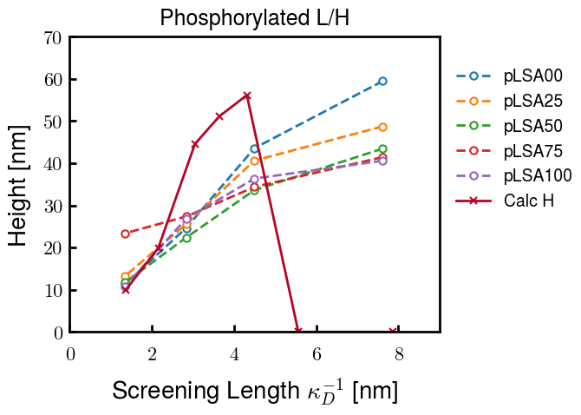
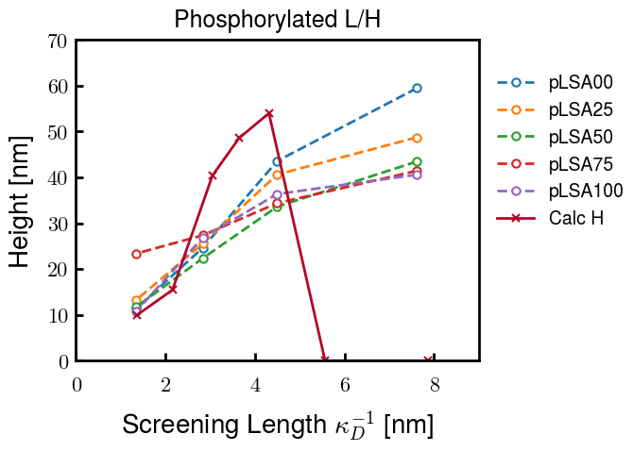
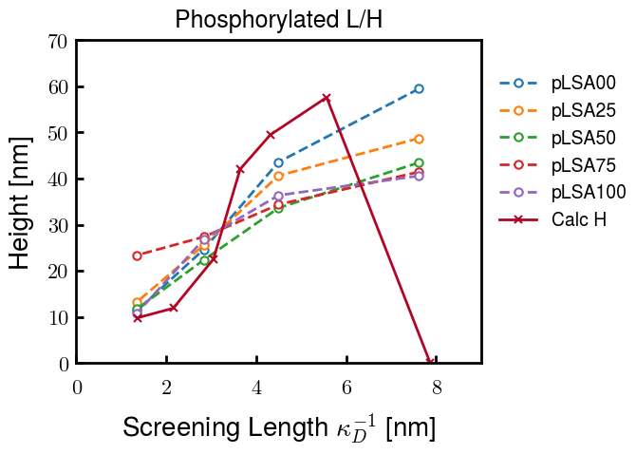
Instead of fitting b/v, could just change value of charge on phos. Try both and see if makes difference for mixture

Slide 23









b2.0 v2.7 c3.2
b3.0 v3.5 c3.5
b3.0 v7.0 c3.5
b3.0 v7.0 c3.0
Phi too small
Phi too small to decrease v0
b4.0 v12.0 c3.0
b5.0 v20.0 c3.0
b5.0 v20.0 c4.0
b5.0 v5.0 c3.0
b5.0 v10.0 c3.0
Phi too small to decrease v0

Slide 24





v20
b5.0 v20.0 c3.0
b4.5 v20.0 c3.0
b4.0 v20.0 c3.0
b3.5 v20.0 c3.0
v10
b5.0 v10.0 c3.0
b4.0 v10.0 c3.0
b3.0 v10.0 c3.0
b2.0 v10.0 c3.0

Slide 25




b2.00 v2.70 c3.20
b2.00 v2.75 c3.20

Slide 26
NFH fitting (from NFL best fit)

Slide 27








b1.00, v0.50, c3.2
b2.00, v4.00, c3.2, th2.5e-02
b1.00, v2.00, c3.2
b1.00, v1.00, c3.2

Slide 28
Mixture

Slide 29



Slide 30


b = 0.75

Slide 31





Slide 32
b = 1.0

Slide 33





Slide 34
b = 1.25

Slide 35




Chi 2.6
Bad vol frac

Slide 36








b25v0
b25v1
b25v2
b25v3

Slide 37




Chi 2.8
Bad vol frac

Slide 38





Slide 39
b = 1.50

Slide 40






Chi 2.8
Bad vol frac

Slide 41





Slide 42

b = 2.00
v4 = 0.25*b^3

Slide 43


Bad vol frac

Slide 44



Slide 45
Fine tune

Slide 46



b1.25, v1.95, c3.0
b1.50, v3.38, c3.0
b2.00, v4.00, c3.0
Norm seems to capture kinked behavior

Slide 47




Slide 48



b1.25, v1.95, c3.2
b1.50, v3.38, c3.2
b2.00, v4.00, c3.2

Slide 49




Slide 50


b1.25
b1.50
b2.00
c2.8
c3.0
c3.2

